Slide 1








HOSPITAL MANAGEMENT SYSTEM.

Slide 2

INTRODUCTION: OVERALL PROJECT OBJECTIVE
A Hospital Management System is a software designed to manage all aspects of a hospital’s operations. It integrates all the information related to patients, doctors, staff, hospital administrative details, etc. into one software.

Slide 3
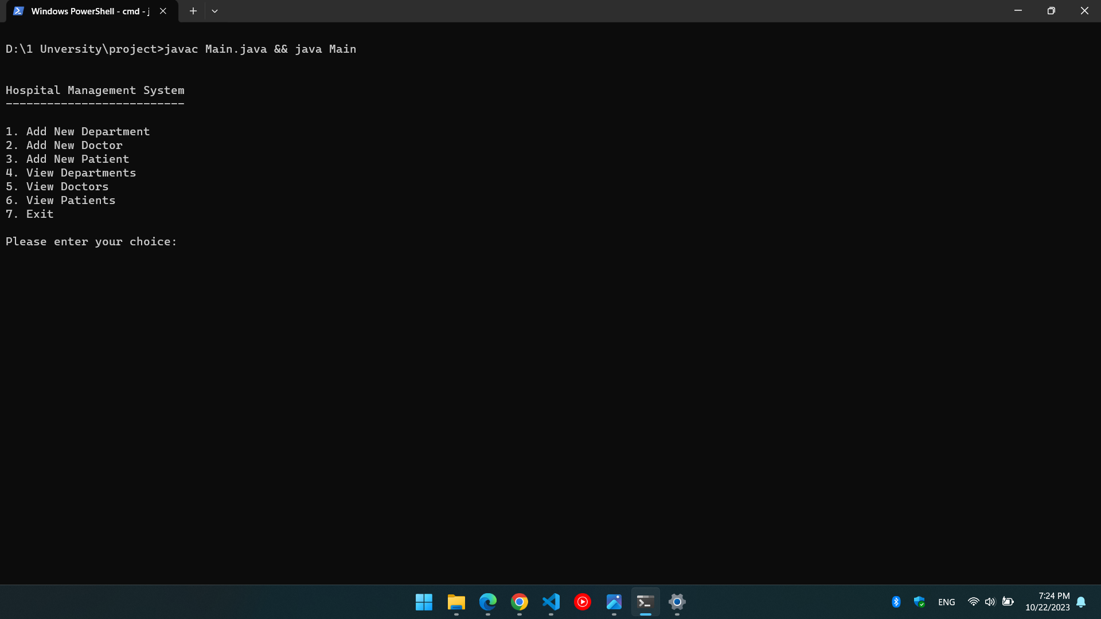
Features in our application

Slide 4
FILE INTRODUCTION IN OUR APPLICATION

Slide 5
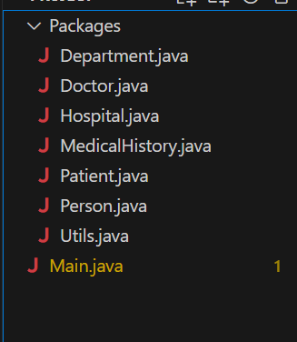

Slide 6
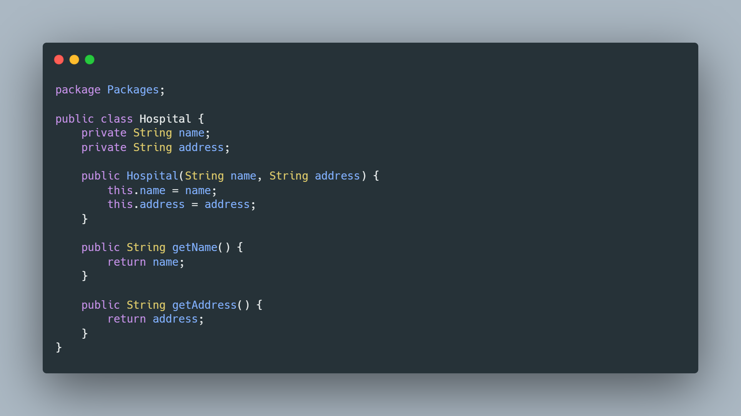
Hospital class

Slide 7
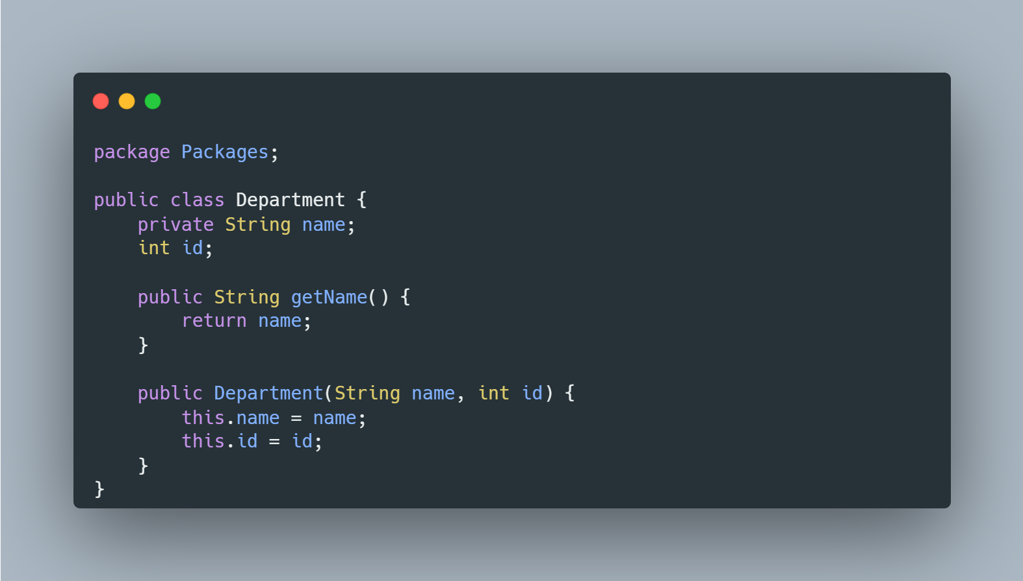
Department class

Slide 8
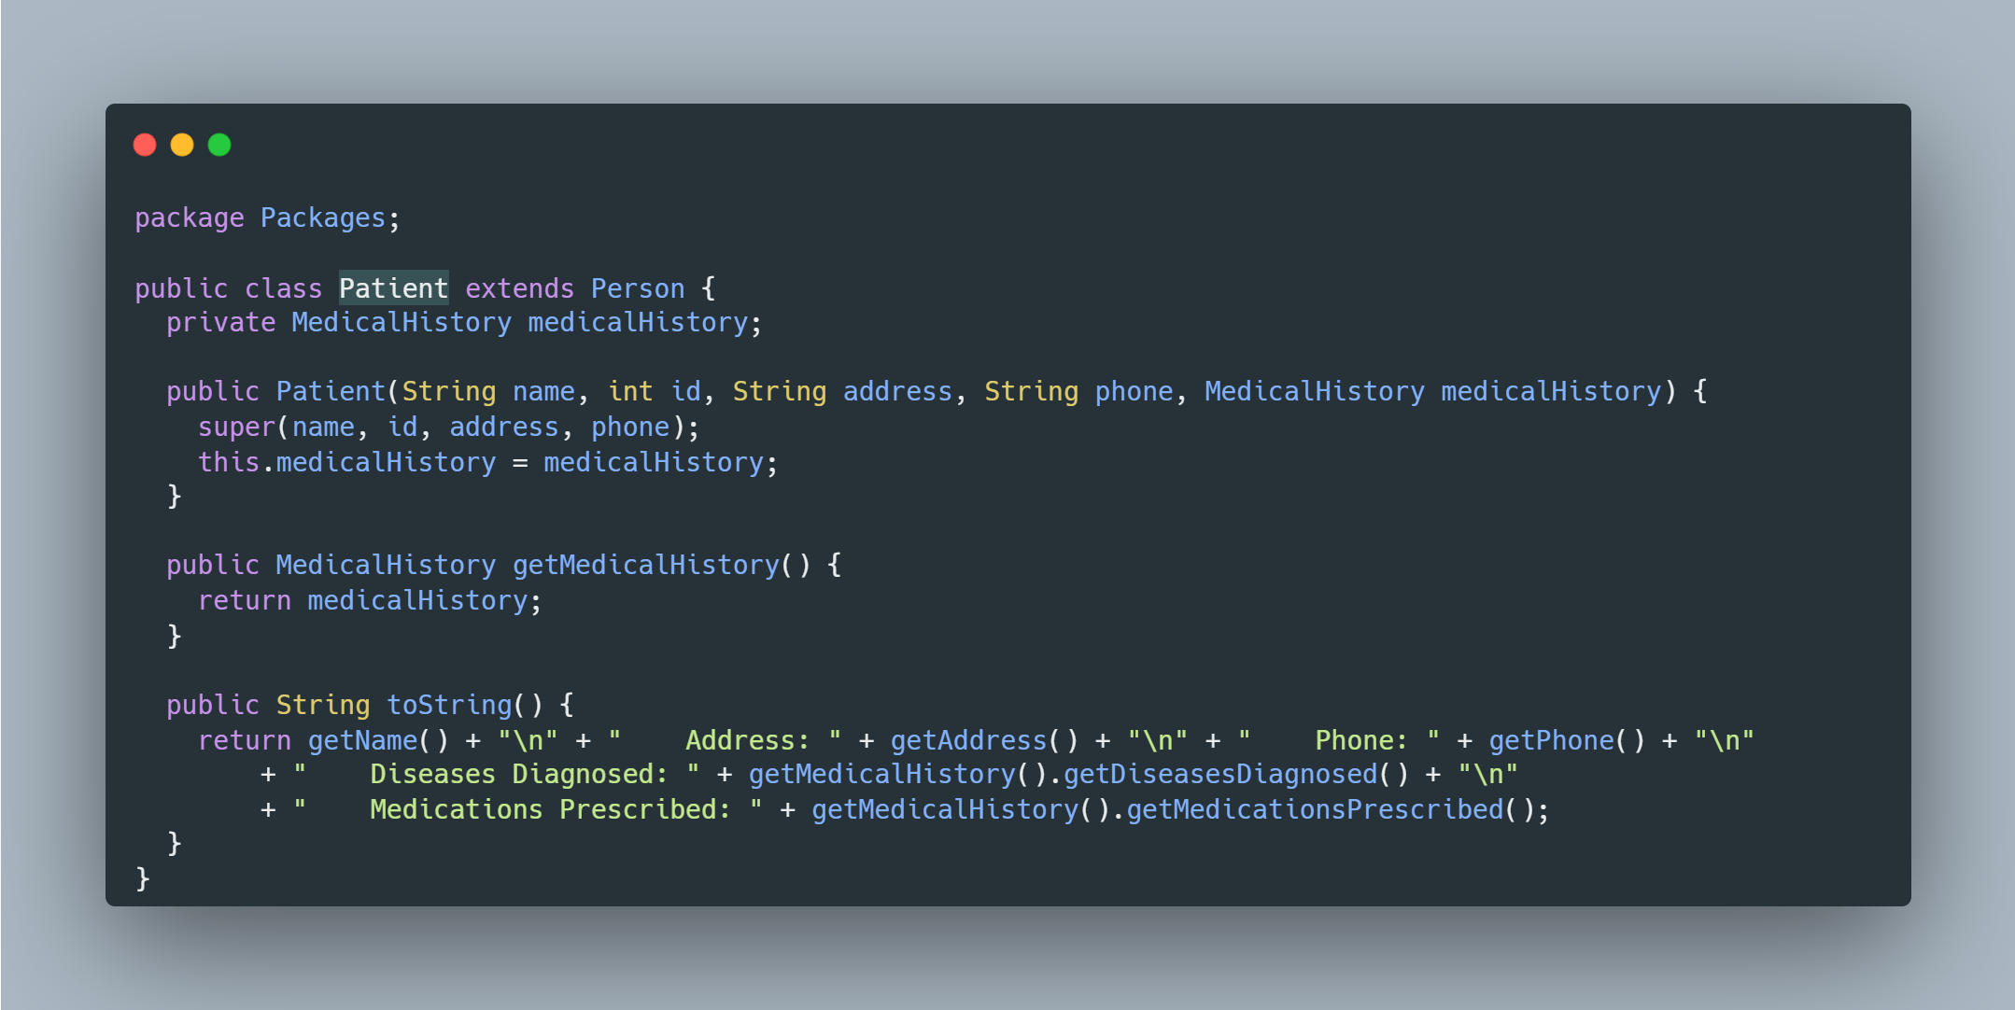
Patient class

Slide 9
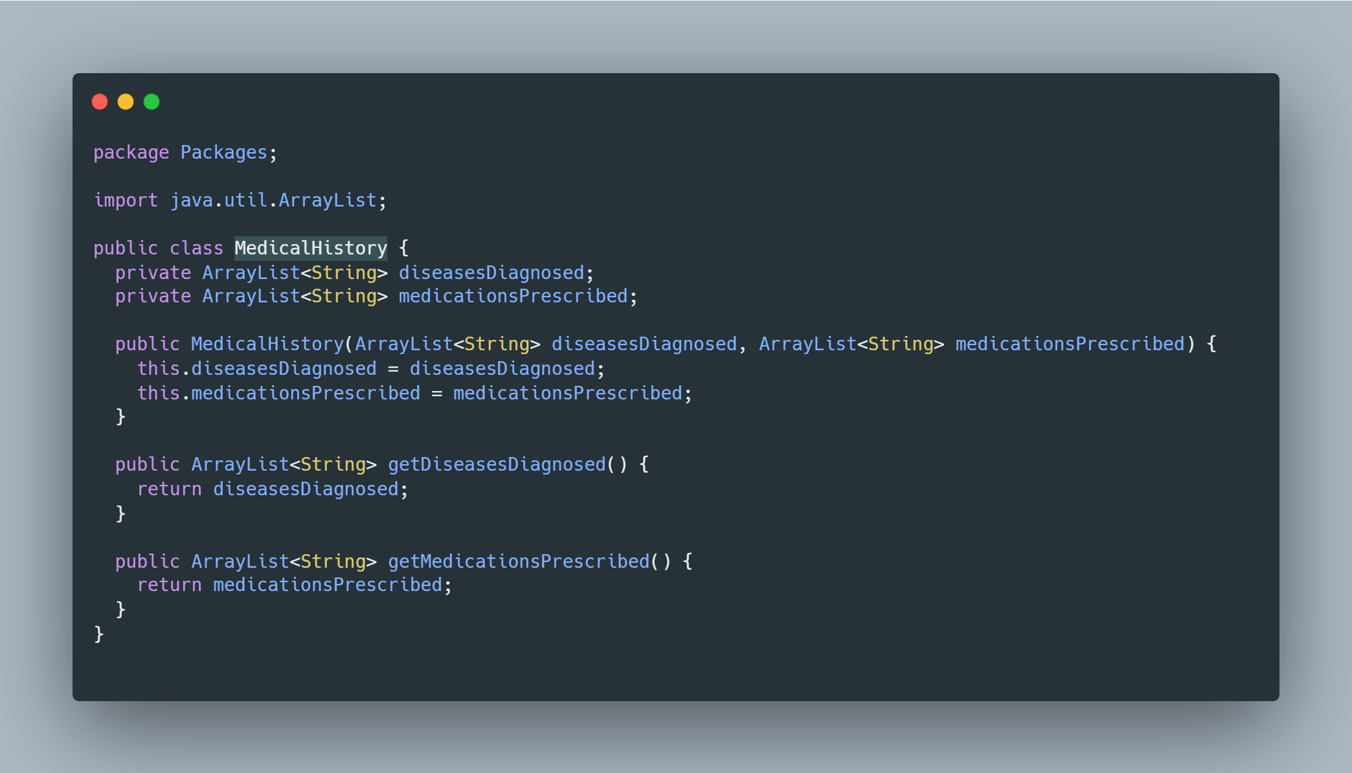
MedicalHistory class

Slide 10
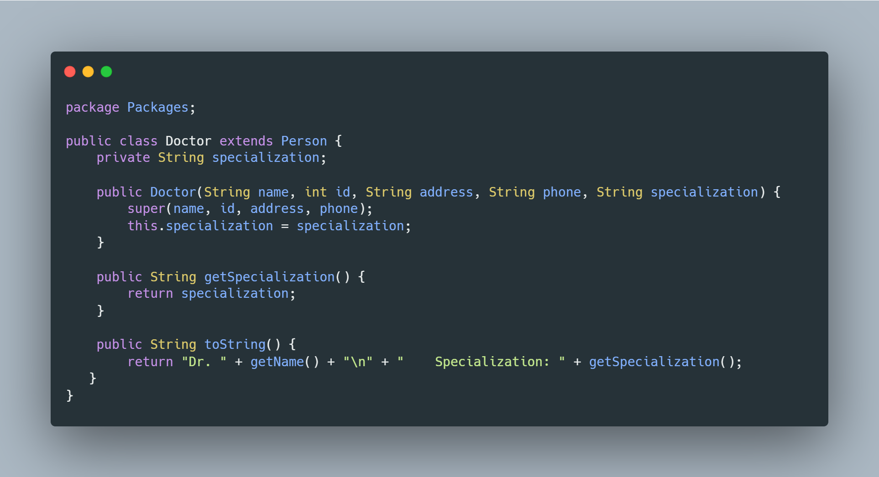
Doctor class

Slide 11
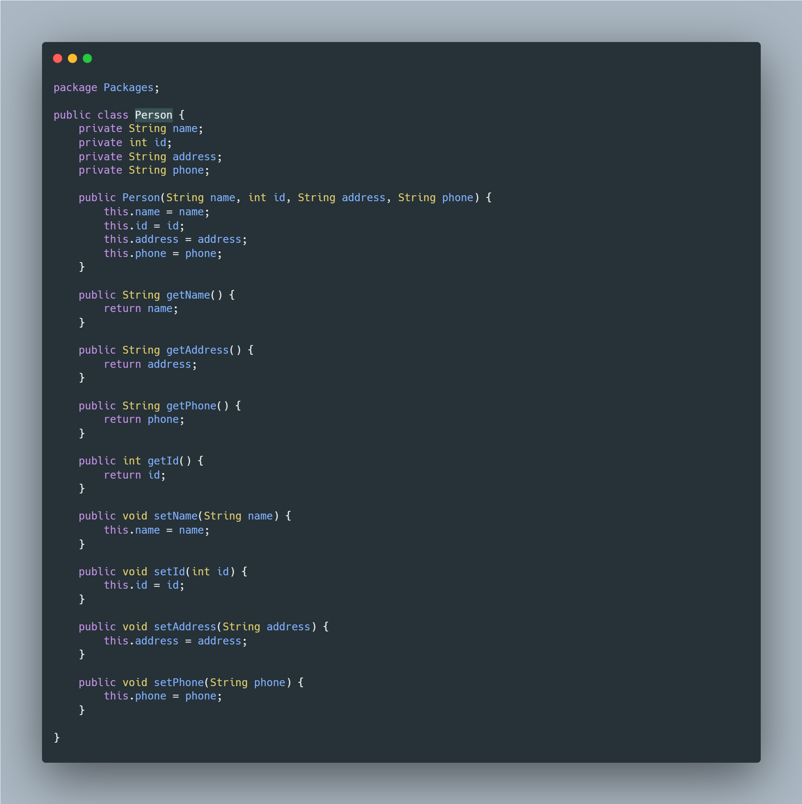
Person class

Slide 13









THANK YOU VERY MUCH!

